Slide 1
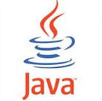
EE基础与应用 翁秀木
Notes:
参考资料
# The Java EE 6 Tutorial Basic Concepts Fourth Edition，Eric Jendrock, Ian Evans, Devika Gollapudi, Kim Haase, Chinmayee Srivathsa著, (据说他们都是Oracle Java EE6 文档团队成员），中文版：Java EE 6权威指南基础篇（第4版）李鹏 韩智译，人民邮电出版社。

Slide 2
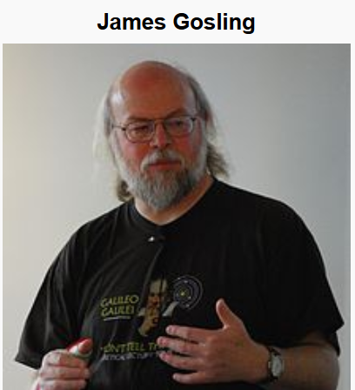

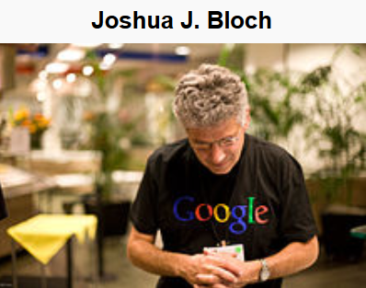

Duke, the Java mascot

Slide 3
为什么要Java EE
益于创建大型、多层、可伸缩、可靠和安全的网络应用程序。
提供开发模型、API和运行环境，给出客户-服务器端模式支持、安全、事务管理、对象-关系式映射、分布式计算、异构系统整合等一系列问题的解决方案、使得开发者可更专注于业务逻辑，并提高生产率。
提供构建Java企业应用程序的标准，借此提高了兼容性，也提高了开发、测试、实施和维护的效率。
Notes:
As stated above, the Java EE platform is designed to help developers create large-scale,
multi-tiered, scalable, reliable, and secure network applications. A shorthand name for
such applications is "enterprise applications," so called because these applications are
designed to solve the problems encountered by large enterprises. Enterprise
applications are not only useful for large corporations, agencies, and governments,
however. The benefits of an enterprise application are helpful, even essential, for
individual developers and small organizations in an increasingly networked world.
The features that make enterprise applications powerful, like security and reliability,
often make these applications complex. The Java EE platform is designed to reduce the
complexity of enterprise application development by providing a development model,
API, and runtime environment that allows developers to concentrate on functionality.
+core j2ee pattern.pdf+P17+
The J2EE Platform offers numerous advantages to the enterprise:
• J2EE establishes standards for areas of enterprise computing
needs such as database connectivity, enterprise business
- 16 -
components, message-oriented middleware (MOM),
Web-related components, communication protocols, and
interoperability.
• J2EE promotes best-of-breed implementations based on open
standards, protecting technological investment.
• J2EE provides a standard platform for building software
components that are portable across vendor implementations,
avoiding vendor lock-in.
• J2EE increases time-to-market since much of the infrastructure
and plumbing is provided by the vendors' products that are
implemented according to the standard J2EE specification. IT
organizations can now get out of the middleware business and
concentrate on building applications for their business.
• J2EE increases programmer productivity, since Java
programmers can relatively easily learn J2EE technologies
based on the Java language. All enterprise software
development can be accomplished under the J2EE platform,
using Java as the programming language.
• J2EE promotes interoperability within existing heterogenous
environments.

Slide 4
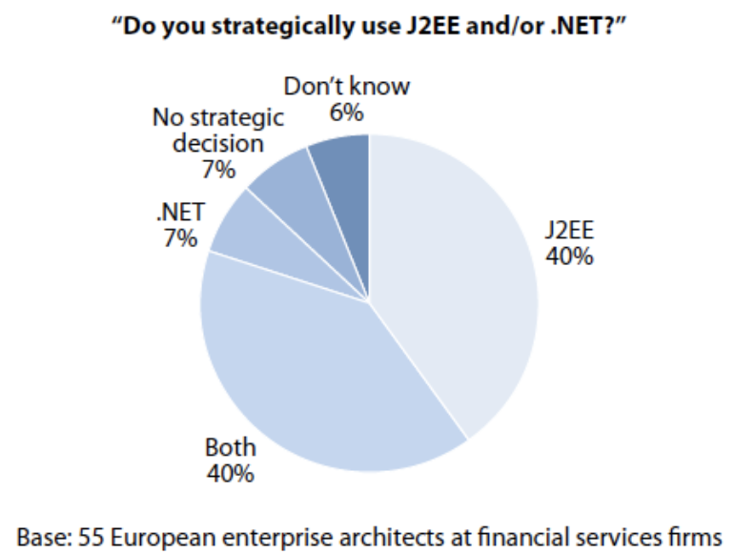
Java EE and .Net

Slide 5
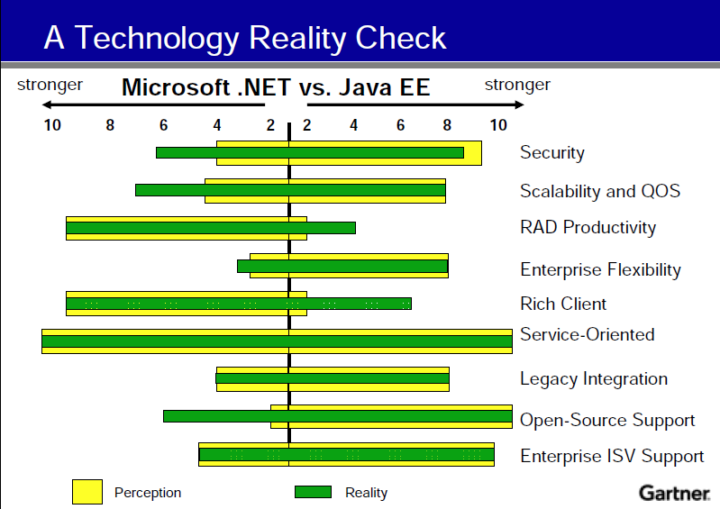
Java EE and .Net
Notes:
QOS = Quality of service
Independent Software Vendors (ISV)
should check in 2010

Slide 6
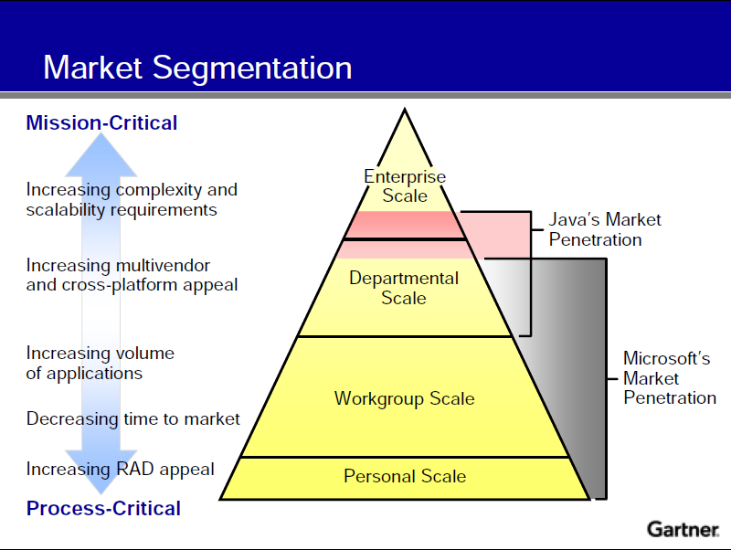

Slide 7
考核方案
学习表现20%
练习和作业（任务）25%
期中测试25%
期末考试30%

Slide 8
内容梗概
Java SE的温故与知新
Java EE的基础学习
Java 开源项目的初涉与应用
应用服务器、IDE等工具的操练

Slide 9
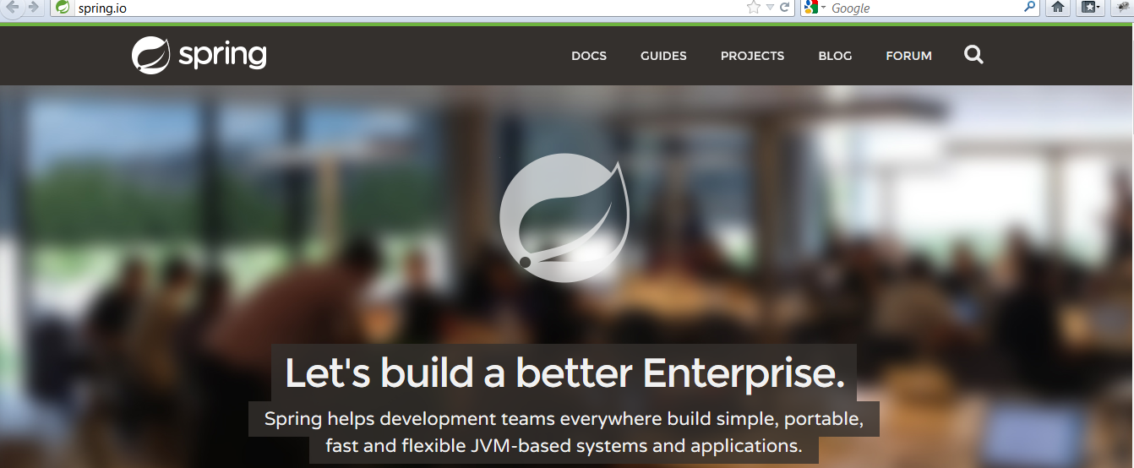
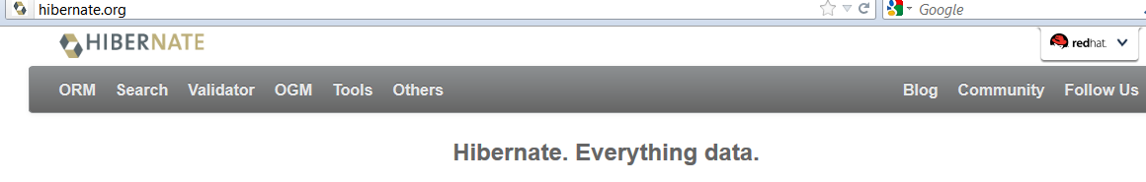

Slide 10
第一回 概述
Java EE的定义
C/S模型和Peer to Peer（点对点）模式
企业应用程序（enterprise application）的分层
Java EE应用实例

Slide 11
学习目标
掌握为什么要Java EE
掌握Java EE的定义，掌握Java EE与Java SE的区别和联系。
掌握C/S模型，了解点对点（Peer to Peer）模型。
掌握企业应用程序的分层和各层的作用，了解各层所用的技术。
了解Java EE应用实例。

Slide 12
Java EE的定义
Java EE=Java Platform，Enterprise Edition or Java Enterprise Edition Platform
Java EE Platform = JVM + Java EE API
Notes:
J2EE = Java 2 Platform, Enterprise Edition
JVM = Java Virtual Machine; API = Application Programming Interface
All Java platforms consist of a Java VirtualMachine (VM) and an application programming
interface (API). The Java VirtualMachine is a program, for a particular hardware and software
platform, that runs Java applications. An API is a collection of software components that you
can use to create other software components or applications. Each Java platform provides a
virtual machine and an API, and this allows applications written for that platform to run on any
compatible system with all the advantages of the Java programming language:
platform-independence, power, stability, ease-of-development, and security.
(From Your First Cup - An Introduction to the Java EE Platform 5.pdf)

Slide 13
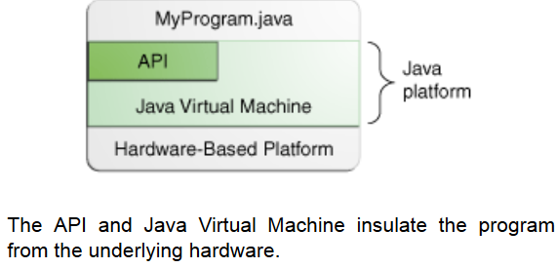
Notes:
A platform is the hardware or software environment in which a program runs. We've already mentioned some of the most popular platforms like Microsoft Windows, Linux, Solaris OS, and Mac OS. Most platforms can be described as a combination of the operating system and underlying hardware. The Java platform differs from most other platforms in that it's a software-only platform that runs on top of other hardware-based platforms.
(From http://docs.oracle.com/javase/tutorial/getStarted/intro/definition.html)

Slide 14
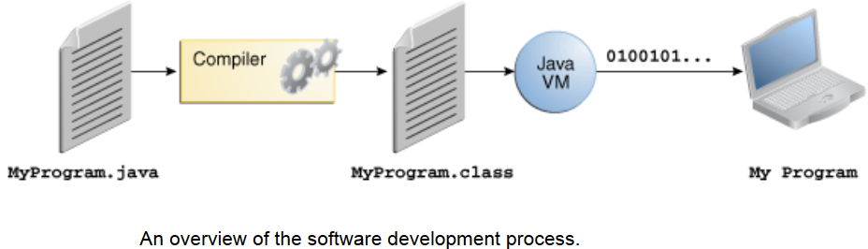

Slide 15
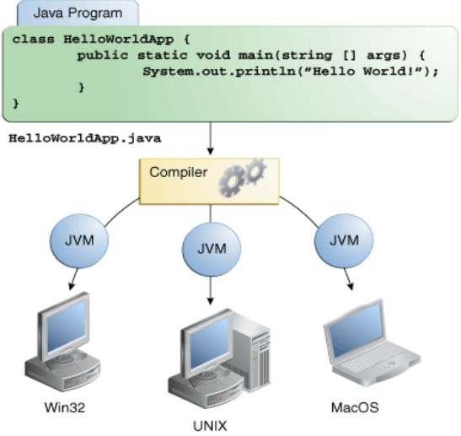

Slide 16
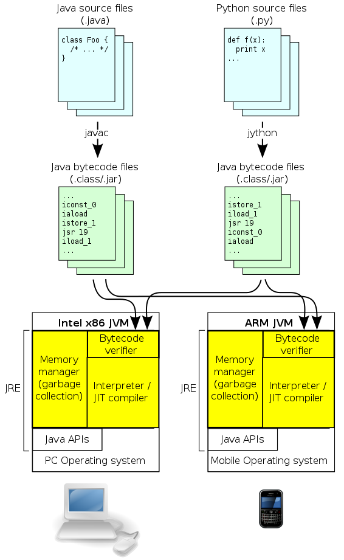
Notes:
One possible optimization, used by Sun's HotSpot Java Virtual Machine, is to combine interpretation and JIT compilation. The application code is initially interpreted, but the JVM monitors which sequences of bytecode are frequently executed and translates them to machine code for direct execution on the hardware. For bytecode which is executed only a few times, this saves the compilation time and reduces the initial latency; for frequently executed bytecode, JIT compilation is used to run at high speed, after an initial phase of slow interpretation. Additionally, since a program spends most time executing a minority of its code, the reduced compilation time is significant. Finally, during the initial code interpretation, execution statistics can be collected before compilation, which helps to perform better optimization.^{[4]}
The correct tradeoff can vary due to circumstances. For example, Sun's Java Virtual Machine has two major modes—client and server. In client mode, minimal compilation and optimization is performed, to reduce startup time. In server mode, extensive compilation and optimization is performed, to maximize performance once the application is running by sacrificing startup time
(From http://en.wikipedia.org/wiki/Just-in-time_compilation)

Slide 17
As a platform-independent environment, the Java platform can be a bit slower than native code.
However, advances in compiler and virtual machine technologies are bringing performance close to that of native code without threatening portability.

Slide 18
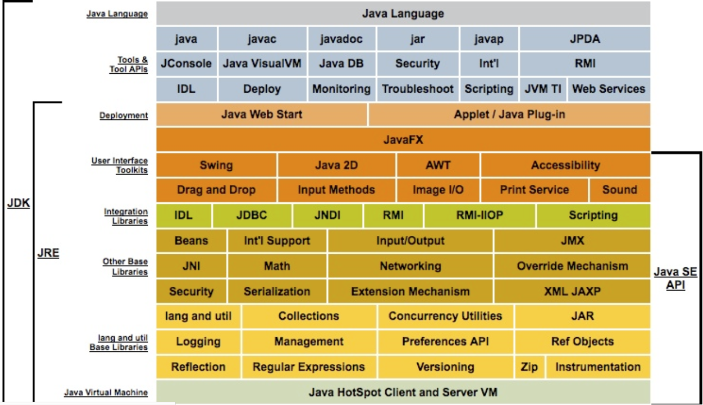
Notes:
这图有些不对：java.exe在jre中也有
From http://www.oracle.com/technetwork/java/javase/tech/index.html
Java SE
When most people think of the Java programming language, they think of the Java SE API. Java
SE's API provides the core functionality of the Java programming language. It defines
everything from the basic types and objects of the Java programming language to high-level
classes that are used for networking, security, database access, graphical user interface (GUI)
development, and XML parsing.
In addition to the core API, the Java SE platform consists of a virtual machine, development
tools, deployment technologies, and other class libraries and toolkits commonly used in Java
applications.
IDL = Interface Definition Language
Java™ IDL is a technology for distributed objects – that is, objects interacting on different platforms across a network. Java IDL enables objects to interact regardless of whether they're written in the Java programming language or another language such as C, C++, COBOL, or others.

Slide 19
Java EE与Java SE的联系与区别
Java EE platform创建在Java SE platform之上.
Java EE 提供API和运行环境，以开发大型、多层、可伸缩、可靠和安全的网络应用程序。

Slide 20
Java EE 7部分技术
Java Servlet 3.1
JavaServer Pages 2.3
JavaServer Faces 2.2
Expression Language 3.0：表达式语言
JavaServer Pages standard Tag Library (JSTL) 1.2
Enterprise JavaBeans 3.2
Java EE Connector Architecture (JCA)
Java Persistence 2.1
Java Message Service API 2.0 ：消息服务
Java API for RESTful Web Services (JAX-RS) 2.0
Java API for XML-Based Web Services (JAX-WS) 2.2
Java Transaction API (JTA) 1.2 ：事务
Java Database Connectivity (JDBC) 4.0
Java Naming and Directory Interface (JNDI)
Notes:
http://www.oracle.com/technetwork/java/javaee/tech/index-jsp-142185.html
In EJB 3.0, Entity Beans were replaced by the Java Persistence API, which was completely separated to its own specification to allow the EJB specification to focus only on the "core session bean and message-driven bean component models and their client API“
(From http://en.wikipedia.org/wiki/Enterprise_JavaBeans)
JavaServer Faces (JSF) is a Java specification for building component-based user interfaces for web applications. It was formalized as a standard through the Java Community Process and is part of the Java Platform, Enterprise Edition.
JSF 2 uses Facelets as its default templating system. Other view technologies such as XUL can also be employed. In contrast, JSF 1.x uses JavaServer Pages (JSP) as its default templating system.
(From http://en.wikipedia.org/wiki/JavaServer_Faces)

Slide 21
Java EE 7部分API的package
javax.jms
javax.resource : Java EE Connector API
javax.servlet
javax.servlet.http
javax.servlet.jsp
javax.servlet.jsp.el
javax.servlet.jsp.jstl.core
javax.transaction.xa : JTA
javax.xml.ws : to create web services
Notes:
http://docs.oracle.com/javaee/7/api/

Slide 22
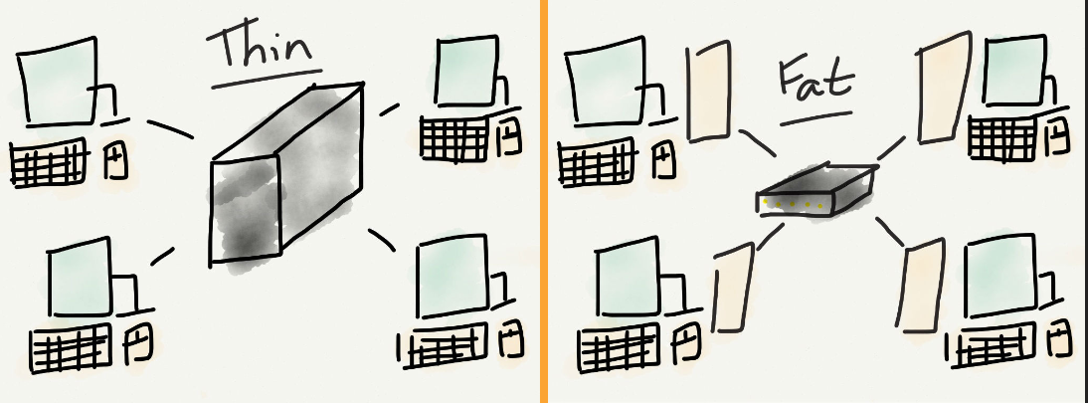
C/S模型: 瘦/肥客户端

Slide 23
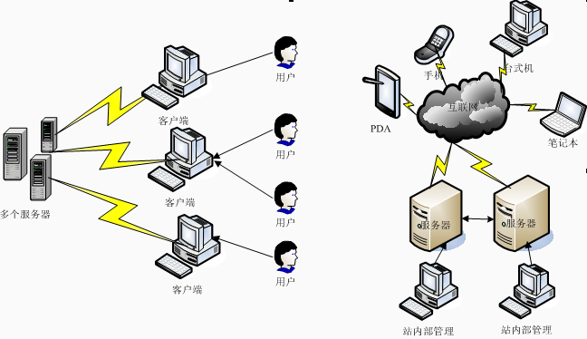
C/S模型：本机应用程序客户端，or浏览器客户端+服务器（ 即B/S）
Notes:
C/S = Client/Server; B/S = Browser/Server
Rich Internet Application： Adobe, Microsoft, JavaFx

Slide 24
富互联网程序 Rich Internet Application
为让客户得到更好的应用程序体验，把一些功能放在客户端能完成，比如多媒体播放、缓存、2d/3d游戏等，从而减少访问服务器时的网络调用消耗。
RIA运行可在Browser内（作为插件或用HTML5），也可独立于Browser，类似传统的本地客户端程序。
主要RIA平台：Adobe's AIR, Microsoft's Silverlight and Oracle's JavaFX
Notes:
Rich-Internet-Application-RIA
This approach allows the client system to handle local activities, calculations, reformatting and so forth, thereby lowering the amount and frequency of client-server traffic, especially as compared to the client-server implementations built around so-called thin clients.
+Adobe AIR++
What's new?
Extensibility
Developers can now give their desktop, iOS, and Android AIR games and applications full access to the latest platform specific features by using AIR native extensions.
Gaming
Enjoy stunning, blazing-fast cinematic 2D and 3D games for desktop, iOS, and Android™. Using fully accelerated GPU rendering and game controller support for gaming at home or on the go.
High Performance
Experience hardware accelerated HD video with smooth playback. Recent improvements allow supported AIR apps and games to deliver responsive feedback even at the most demanding times
+++
The next frontier of corporate development may well be Rich Internet Applications. RIAs are Internet applications which do not necessarily run in the browser and are free of user-interface limitations of that environment. Corporate development went head first into conventional Internet application development before the enormous security implications of that platform were clear.
http://www.eweek.com/c/a/Security/Rich-Internet-Applications-The-Next-Frontier-of-Corporate-Development-732651/

Slide 25
富互联网程序 Rich Internet Application
JavaFX是一种富客户端平台（rich client platform），它目的是为了给企业应用程序提供一个轻量级、速度更快的Java用户界面。
JavaFX 可以调用本地系统的功能，也可以无缝连接到服务器端的应用程序。
Notes:
JavaFX - The Rich Client Platform
JavaFX is the next step in the evolution of Java as a rich client platform. It is designed to provide a lightweight, hardware-accelerated Java UI platform for enterprise business applications. With JavaFX, developers can preserve existing investments by reusing Java libraries in their applications. They can even access native system capabilities, or seamlessly connect to server-based middleware applications.

Slide 26
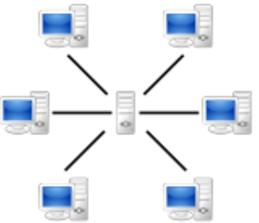
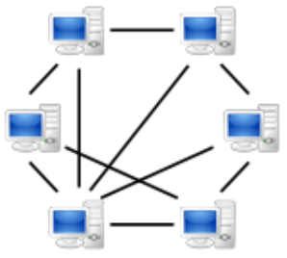
C/S（左）vs. peer to peer（右）

Slide 27
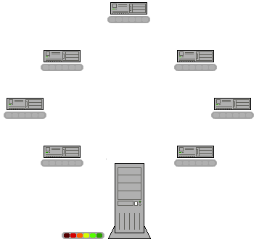
Notes:
The BitTorrent protocol: In this animation, the colored bars beneath all of the 7 clients in the upper region above represent the file being shared, with each color representing an individual piece of the file. After the initial pieces transfer from the seed (large system at the bottom), the pieces are individually transferred from client to client. The original seeder only needs to send out one copy of the file for all the clients to receive a copy.
(From http://en.wikipedia.org/wiki/Peer-to-peer)

Slide 28
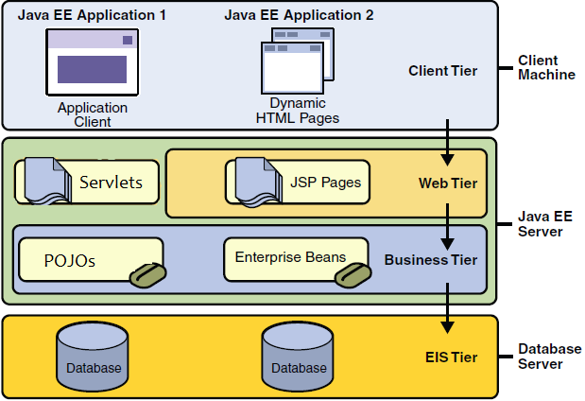
Java EE应用程序的分层结构
Notes:
The Client Tier
The client tier consists of application clients that access a Java EE server and that are usually
located on a different machine from the server. The clients make requests to the server. The
server processes the requests and returns a response back to the client. Many different types of
applications can be Java EE clients, and they are not always, or even often Java applications.
Clients can be a web browser, a stand-alone application, or other servers, and they run on a
different machine from the Java EE server.
The Web Tier
The web tier consists of components that handle the interaction between clients and the
business tier. Its primary tasks are the following:
■ Dynamically generate content in various formats for the client.
■ Collect input from users of the client interface and return appropriate results from the
components in the business tier.
■ Control the flow of screens or pages on the client.
■ Maintain the state of data for a user's session.
■ Perform some basic logic and hold some data temporarily in JavaBeans components.
The Business Tier
The business tier consists of components that provide the business logic for an application.
Business logic is code that provides functionality to a particular business domain, like the
financial industry, or an e-commerce site. In a properly designed enterprise application, the
core functionality exists in the business tier components.
Java EE Technologies Used in the Business Tier
The following Java EE technologies are used in the business tier in Java EE applications:
■ Enterprise JavaBeans (EJB) components, referred to here as enterprise beans
■ JAX-WS web service endpoints
■ Java Persistence API entities
The Enterprise Information Systems Tier
The enterprise information systems (EIS) tier consists of database servers, enterprise resource
planning systems, and other legacy data sources, like mainframes. These resources typically are
located on a separate machine than the Java EE server, and are accessed by components on the
business tier.
Java EETechnologies Used in the EISTier
The following Java EE technologies are used to access the EIS tier in Java EE applications:
■ The JavaDatabase Connectivity API (JDBC)
■ The Java Persistence API
■ The J2EE Connector Architecture
■ The Java Transaction API (JTA)

Slide 29
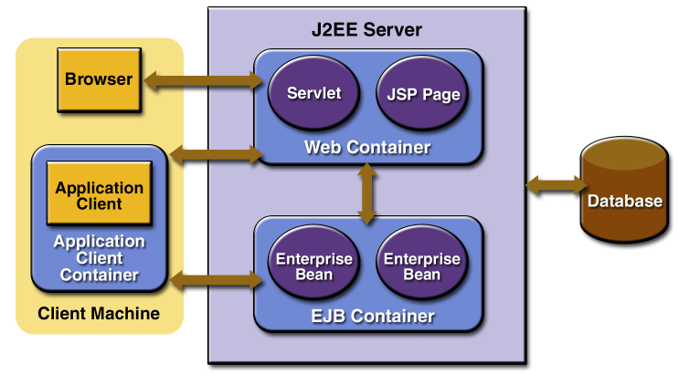
Java EE应用程序的分层结构
Notes:
Web container (also known as a Servlet container) is the component of a web server that interacts with Java servlets. A web container is responsible for managing the lifecycle of servlets, mapping a URL to a particular servlet and ensuring that the URL requester has the correct access rights. A web container implements the web component contract of the Java EE architecture, specifying a runtime environment for web components that includes security, concurrency, lifecycle management, transaction, deployment, and other services. A web container provides the same services as a JSP container as well as a federated view of the Java EE platform APIs
http://en.wikipedia.org/wiki/Web_container
++++++++++++++++

Slide 30
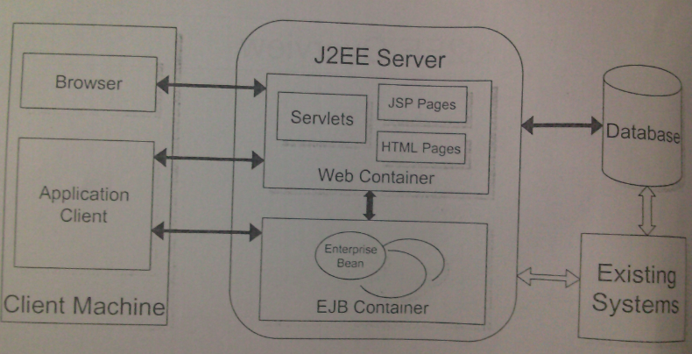

Slide 31
客户端层（client tier）
客户端层由应用程序的客户端组成，客户端包括有万维网浏览器（web browser）和本机应用程序。 Java EE的本机应用程序客户端主要是Java程序，但也可以不是Java程序。
客户端通常与应用服务器不在一个机器上，可以是桌面电脑、手提电脑、手机、PAD等。
客户端向服务器发出请求，服务器处理请求后，再将结果返回给客户端。
Notes:
The client tier consists of application clients that access a Java EE server and that are usually located on a different machine from the server.
The clients make requests to the server. The server processes the requests and returns a response back to the client. Many different types of applications can be Java EE clients, and they are not always, or even often Java applications.
Clients can be a web browser, a stand-alone application, or other servers, and they run on a different machine from the Java EE server.

Slide 32
Web层 （ Web Tier or UI Tier）
Web层组件负责处理客户端和业务层之间的交互，其主要任务有：
动态产生不同格式的内容，供客户端使用。
获取客户端用户的输入，并调用业务层的组件，以返回适当的结果。
控制页面流转
维护用户会话（Session）中的数据。
执行基本逻辑并把一些数据暂存在JavaBean组件内。
Notes:
Web层的组件主要处理客户端和业务层之间的交互，其主要任务有：
动态产生不同格式的内容，供客户端使用。
收集客户端用户的输入
The web tier consists of components that handle the interaction between clients and the business tier. Its primary tasks are the following:
■ Dynamically generate content in various formats for the client.
■ Collect input from users of the client interface and return appropriate results from the components in the business tier.
■ Control the flow of screens or pages on the client.
■ Maintain the state of data for a user's session.
■ Perform some basic logic and hold some data temporarily in JavaBeans components.

Slide 33
业务层（Business Tier or Middle Tier）
业务层的组件负责提供业务逻辑。
业务逻辑是一些提供了某个业务领域功能的代码，例如金融行业或者电子商务网站。
设计企业应用程序时，应把业务领域功能放在业务层的组件中来实现。
Java EE服务器为业务层提供事务管理和连接缓冲池
Notes:
The Business Tier
The business tier consists of components that provide the business logic for an application.
Business logic is code that provides functionality to a particular business domain, like the financial industry, or an e-commerce site. In a properly designed enterprise application, the core functionality exists in the business tier components.

Slide 34
企业信息系统层
（ Enterprise Information Systems Tier）
EIS层的组件（资源）通常包括数据库服务器，ERP系统，或其他的现有系统，例如大机（mainframe）上的系统.
EIS层的组件（资源）与Java EE server往往不在一个物理机器, 需要通过业务层的组件来访问它们。
Java EE提供JDBC、JNDI、JCA、JMS等来访问EIS层
Notes:
The Enterprise Information Systems Tier
The enterprise information systems (EIS) tier consists of database servers, enterprise resource
planning systems, and other legacy data sources, like mainframes.
These resources typically are located on a separate machine than the Java EE server, and are accessed by components on the business tier.

Slide 35
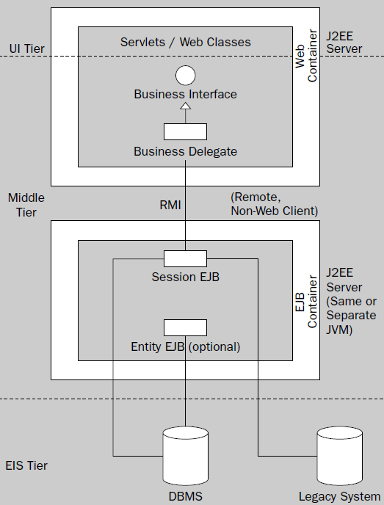
经典Java EE架构 - 远程调用的EJB架构
Notes:
“Classic” J2EE Architecture
优点：1业务层可以放在独立的物理机上，并置于安全性更高的防火墙背后，保障核心业务逻辑的安全。
2业务层可以放在独立的物理机集群上，提高可伸缩性scalability
缺点：1方案复杂，需要更多的项目资源，还容易导致bug
2远程调用使系统效率降低
3业务层的组件难以测试
+core j2ee pattern.pdf P77+++++++++++
Decouple the clients from the business tier and hide the business-tier
implementation details from clients, using business delegates. Business delegates
intercept all service exceptions and may throw an application exception. Business
delegates are plain Java objects that are local to the client. Typically, business
delegates are developed by the EJB developers and provided to the client
developers
+core j2ee pattern.pdf ++++P110+++++++
Use a business delegate to decouple the tiers and to hide the implementation
details.
Session beans are used to implement facades for entity beans, as discussed in
“Wrap Entities With Session” . Session beans provide coarse-grained interfaces to
business services. But, exposing the session bean directly to the application client
creates a tight coupling between the application client code and the session bean.
Exposing the session bean to the application client increases the prevalence of
session bean calls throughout the client code. Thus, any change to the session bean
interface impacts every point in the application client code where the session bean
is called, and thus creates highly brittle code. The clients also are exposed to service
level exceptions encountered when dealing with enterprise beans. This effect is
further exaggerated if you consider applications with different types of clients,
where each such client uses the session bean interface to obtain some service.

Slide 36
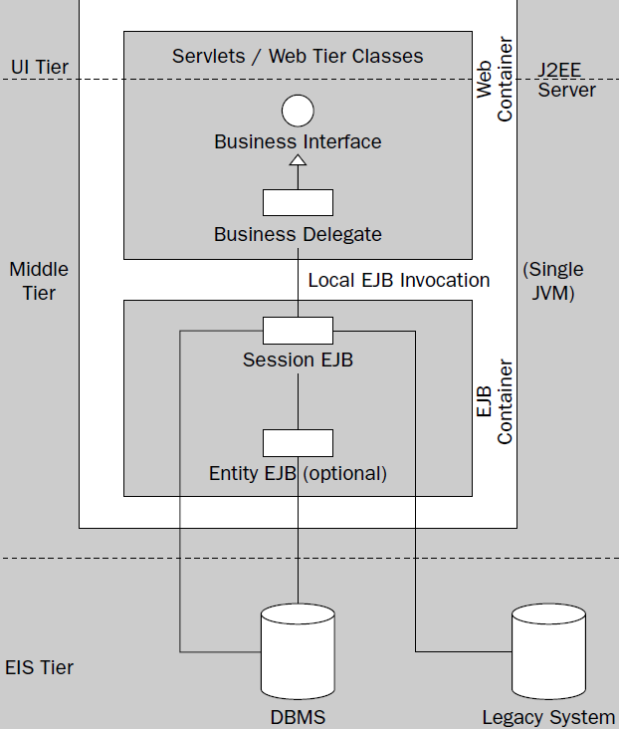
本地调用EJB的架构
Notes:
Local EJB Architecture
优点：

Slide 37
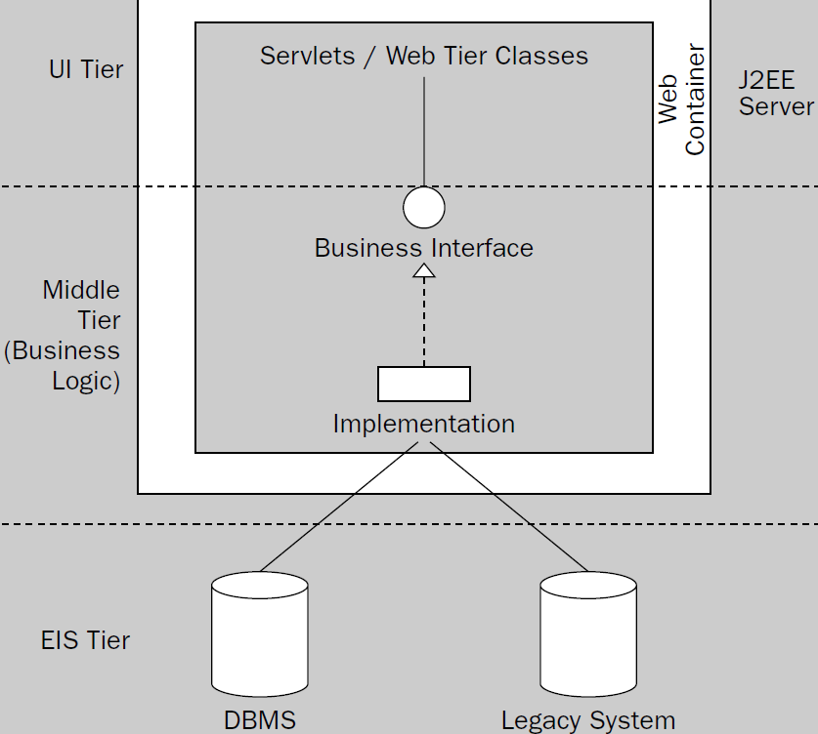
简单的架构，无EJB
Notes:
Ad hoc J2EE Architecture without EJB

Slide 38
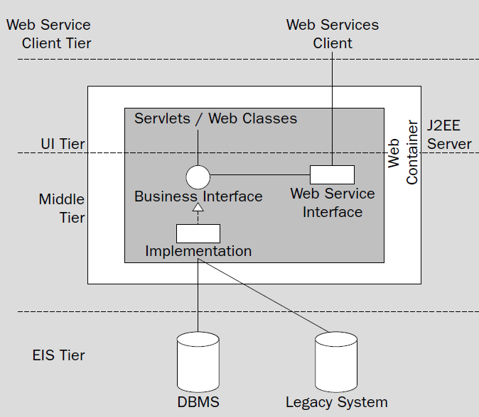
web service架构，无EJB
Notes:
Web Service客户端可以是Android或iOS手机

Slide 39
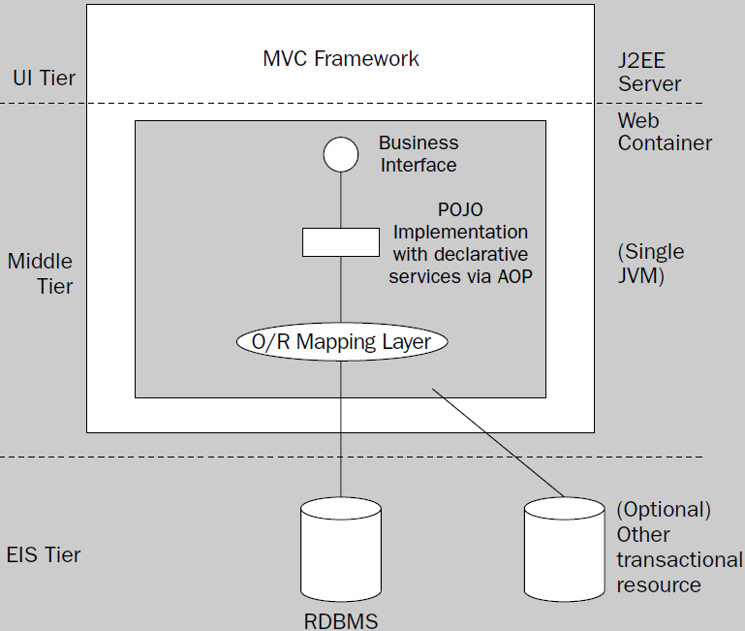
轻量级容器的架构，无EJB
Notes:
The “Lightweight Container” Architecture

Slide 40
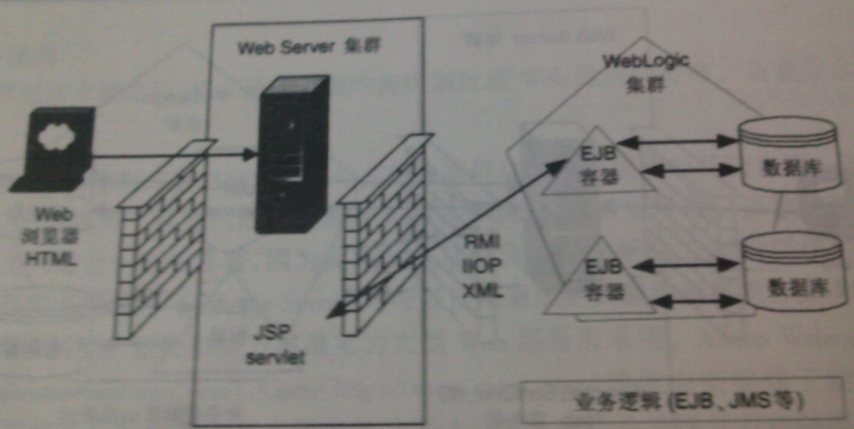
Java EE应用实例 1

Slide 41
未完待续，谢谢！

